Slide 1

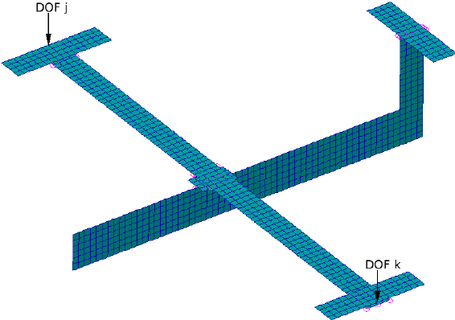


Scaled Aircraft in Aeroelastic Similarity – Flutter Optimization
Masters Research Project
Scale <1
Reference
Scale >1
By
Akshay GUPTA, MAE 1
Under the supervision of
Professor Joseph MORLIER (ISAE SUPAERO - DMSM)
Joan MAS COLOMER (PhD Candidate, ONERA)
(2017-18)

Slide 2
Roadmap
Project Plan
State of the Art: Aeroelasticity & Flutter
State of the Art: Aeroelastic scaling
State of the Art: Optimization Methodologies
Modal Optimization Formulation
Let’s keep this a secret
Tools Framework
Adapted scaling & optimization methodologies
Optimizer specificities
Test Cases
Results
Perspectives

Slide 3
About the Project
Goal: Aeroelastic static scaling and flutter optimization of Blended Wing Body model
Semester 2
Aeroelasticity & flutter
Aeroelastic scaling theory (with flow similarities)
OpenMDAO tutorials
Modal optimization of GOLAND wing
Modal Optimization of GARTEUR SM-AG19
Semester 3
Aeroelastic static scaling (with flow non-similarities)
Modal dynamics of BWB
Flutter analysis of BWB
Flutter optimization of BWB
Research paper

Slide 4
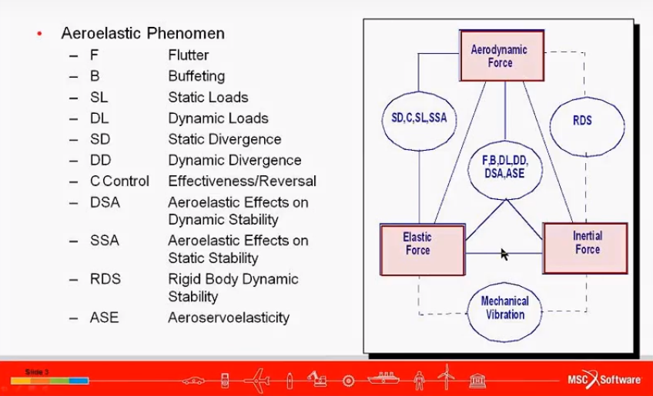
Aeroelasticity : The Aeroservoelastic Triangle
Linearized Dynamic Aeroelastic Equation
$$\left.\left[M\right]\left\{\ddot{x}\right\}+\left[K\right]\left\{x\right\}=\left[A_{k}\right]\left\{x\right\}+\left[A_{c}\right]\left\{\dot{x}\right\}+ \left[A_{m}\right]\left\{\ddot{x}\right\}+\left[M\right]\{a_{g}\right\}$$
where: [M] – Mass Matrix {a_{g}} - Gravitational accelerations vector
{x} – vector of elastic and rigid body DOFs [A_{k}], [A_{c}], and [A_{m}] - Aerodynamic matrices

Slide 5
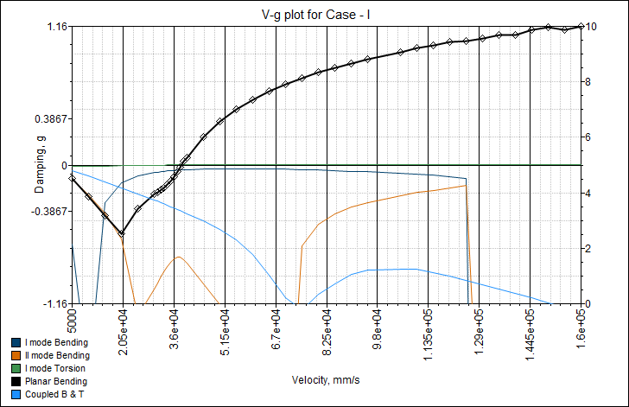
Flutter: A Dynamic Instability
Classical (bending and torsion) flutter – Potential Flow – Linear
Stall flutter – continuous attachment and detachment of flow – aerodynamic non-linearity
Limit Cycle Oscillation (LCO) – (can be) Non-linear – Structural or aerodynamic
Buffeting – wing downstream (unsteady) flow causing tail to vibrate
The VIDEO here has been removed due to GITHUB file size limit.
[*] Akshay Gupta. Nanjing University of Aeronautics and Astronautics, 2016
Notes:
Normally – Positive structural damping, negative aerodynamic damping
Flutter point – negative structural damping, zero aerodynamic damping
g=fictitious damping used in the flutter equation to detect flutter point. g=0 means flutter point. At V=0, g=0 but there is no aerodynamics at that point, its just a spring mass damper system.
Flutter phenomenon is also a result of coupling of several degrees of freedom, which is also an essential feature of flutter. The past experiments proves that most of the times the bending deformations across the span are in phase with one another. Similarly, the torsional movements across the span are in phase, but the bending is significantly out of phase from the torsional deformation. This phase difference is responsible for occurrence of the flutter phenomenon.

Slide 6
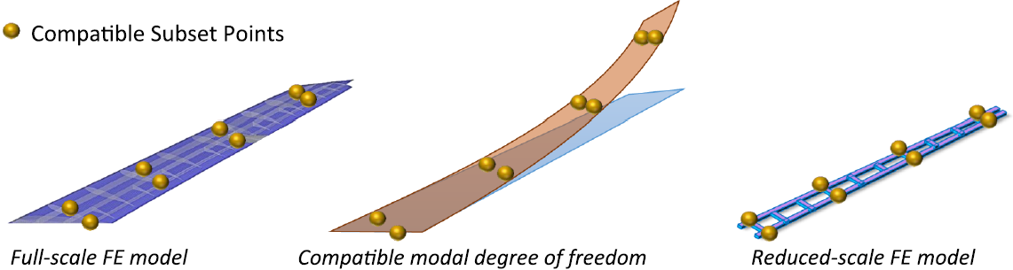
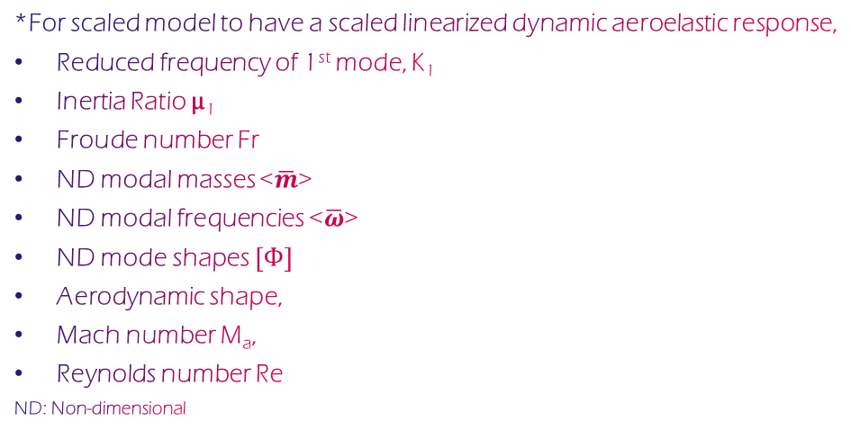
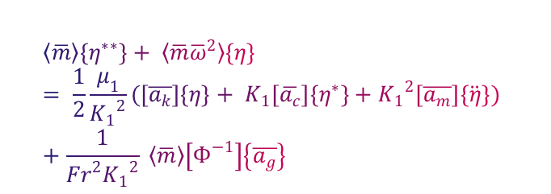
Aeroelastic Scaling
The Final form of the nondimensional linear aeroelastic equation*,
$$〈\overline{m}〉\left\{η^{∗∗}\right\}+ 〈{\overline{m}\overline{ω}}^{2}〉\left\{η\right\}= \frac{1}{2}\frac{μ_{1}}{{K_{1}}^{2}}(\left[\overline{a_{k}}\right]\left\{η\right\}+ K_{1}\left[\overline{a_{c}}\right]\left\{η^{∗}\right\}+{K_{1}}^{2}\left[\overline{a_{m}}\right]\left\{\ddot{η}\right\}) +\frac{1}{{Fr}^{2}{K_{1}}^{2}} 〈\overline{m}〉\left[Ф^{−1}\right]\left\{\overline{a_{g}}\right\}$$
# Building a Scaled Model
*For scaled model to have a scaled linearized dynamic aeroelastic response,
Reduced frequency of 1st mode, K₁
Inertia Ratio μ₁
Froude number Fr
ND modal masses <$\overline{m}$>
ND modal frequencies <$\overline{ω}$>
ND mode shapes $\left[Ф\right]$
Aerodynamic shape,
Mach number M_{a},
Reynolds number Re
ND: Non-dimensional
* Ricciardi et al., AIAA 2014
# Ricciardi et al., Journal of Aircraft, 2016
#Linearized Flutter Mode Comparison

Slide 7
Optimization Methodologies*
Modal Response Direct Matching
Modal Response Matching through Mass and Stiffness
One optimization loop
Mass and stiffness optimized in the same routine
Drawback – gradient based method not suitable, some areas can be very heavy
Mass and stiffness optimized in separate routines
Drawback – requires additional set of displacements under given load
* Richards et al., AIAA 2009-2218

Slide 8
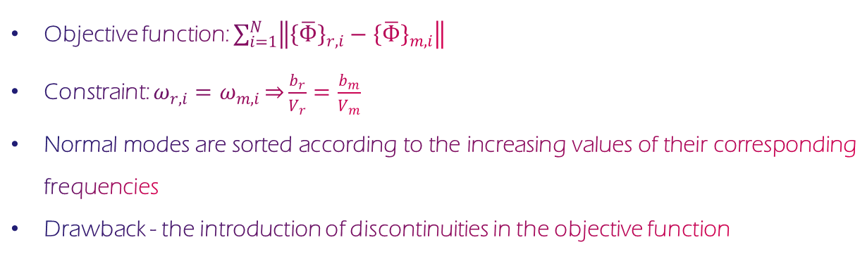
Modal Optimization Formulation
Traditional*
Objective function: $\sum_{i=1}^{N}{\left\|{\left\{\overline{Ф}\right\}}_{r,i}−{\left\{\overline{Ф}\right\}}_{m,i}\right\|}$
Constraint: $ω_{r,i}=ω_{m,i}\overset{⇒}{}\frac{b_{r}}{V_{r}}=\frac{b_{m}}{V_{m}}$
Normal modes are sorted according to the increasing values of their corresponding frequencies
Drawback - the introduction of discontinuities in the objective function
* Ricciardi et al., AIAA, (2014)

Slide 9
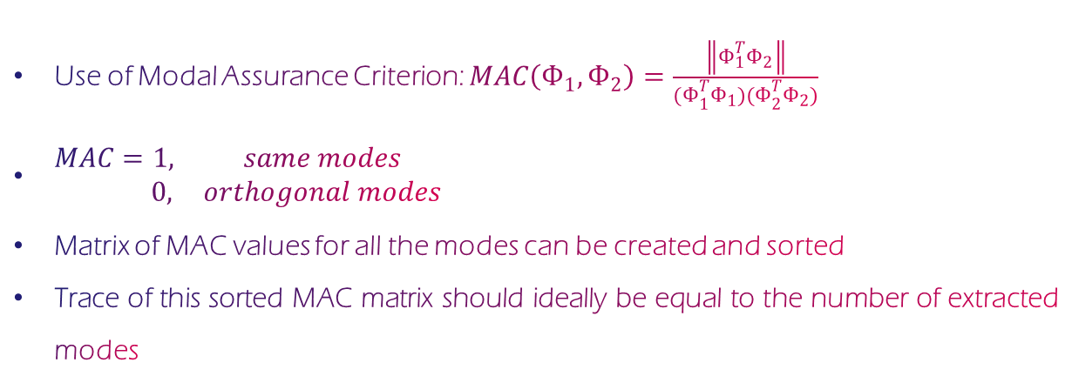
Modal Optimization Formulation
Improved Idea*
Use of Modal Assurance Criterion: $MAC\left(Ф_{1},Ф_{2}\right)=\frac{\left\|Ф_{1}^{T}Ф_{2}\right\|}{{(Ф}_{1}^{T}Ф_{1}{)(Ф}_{2}^{T}Ф_{2})}$
$\begin{matrix}MAC=1, & same modes \\ 0, & orthogonal modes\end{matrix}$
Matrix of MAC values for all the modes can be created and sorted
Trace of this sorted MAC matrix should ideally be equal to the number of extracted modes
* Mas Colomer et al., AIAA, 2017

Slide 10
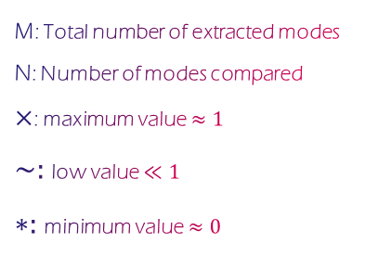
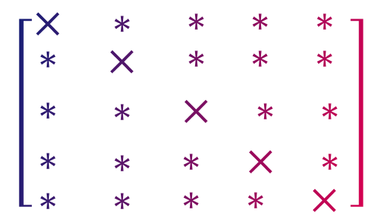
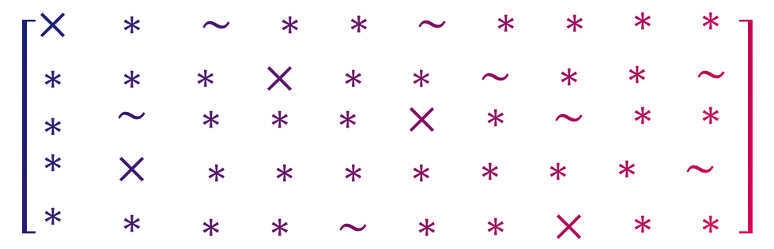
Illustration of MAC Matrix sorting
______________________M_________________________
$$\left[\begin{matrix}× & ∗ & \begin{matrix}\sim & ∗ & \begin{matrix}∗ & \sim & \begin{matrix}∗ & ∗ & \begin{matrix}∗ & ∗\end{matrix}\end{matrix}\end{matrix}\end{matrix} \\ ∗ & ∗ & \begin{matrix}∗ & × & \begin{matrix}∗ & ∗ & \begin{matrix}\sim & ∗ & \begin{matrix}∗ & \sim \end{matrix}\end{matrix}\end{matrix}\end{matrix} \\ \begin{matrix}∗ \\ \begin{matrix}∗ \\ ∗\end{matrix}\end{matrix} & \begin{matrix}\sim \\ × \\ ∗\end{matrix} & \begin{matrix}\begin{matrix}∗ & ∗ & \begin{matrix}∗ & × & \begin{matrix}∗ & \sim & \begin{matrix}∗ & ∗\end{matrix}\end{matrix}\end{matrix}\end{matrix} \\ \begin{matrix}∗ & ∗ & \begin{matrix}∗ & ∗ & \begin{matrix}∗ & ∗ & \begin{matrix}∗ & \sim \end{matrix}\end{matrix}\end{matrix}\end{matrix} \\ \begin{matrix}∗ & ∗ & \begin{matrix}\sim & ∗ & \begin{matrix}∗ & × & \begin{matrix}∗ & ∗\end{matrix}\end{matrix}\end{matrix}\end{matrix}\end{matrix}\end{matrix} \right]$$
Before Sorting
N
___________N____________
$$\left[\begin{matrix}× & ∗ & \begin{matrix}∗ & ∗ & ∗\end{matrix} \\ \begin{matrix}∗ \\ ∗ \\ ∗\end{matrix} & \begin{matrix}× \\ ∗ \\ ∗\end{matrix} & \begin{matrix}\begin{matrix}∗ & ∗ & ∗\end{matrix} \\ \begin{matrix}× & ∗ & ∗\end{matrix} \\ \begin{matrix}∗ & × & ∗\end{matrix}\end{matrix} \\ ∗ & ∗ & \begin{matrix}∗ & ∗ & ×\end{matrix}\end{matrix} \right]$$
M: Total number of extracted modes
N: Number of modes compared
$×$: maximum value $≈1$
$\sim :$low value $≪1$
$∗:$minimum value $≈0$
After Sorting
N

Slide 11
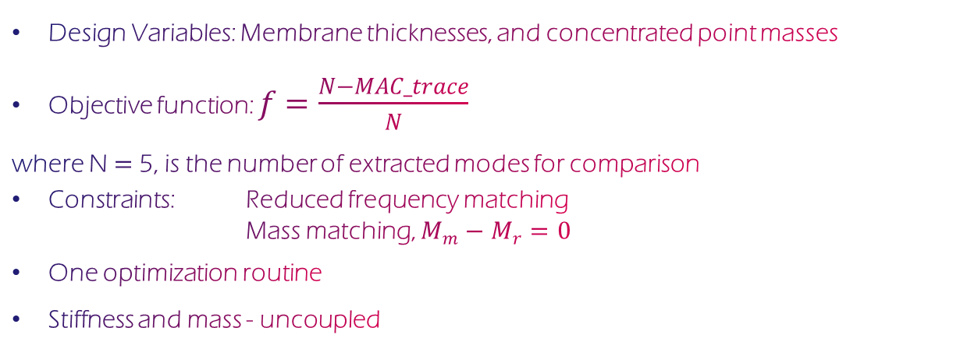
Modal Optimization Formulation (Adapted)
Design Variables: Membrane thicknesses, and concentrated point masses
Objective function: $f=\frac{N−MAC_trace}{N}$
where N $=$5, is the number of extracted modes for comparison
Constraints: Reduced frequency matching
Mass matching, $M_{m}−M_{r}=0$
One optimization routine
Stiffness and mass - uncoupled

Slide 12
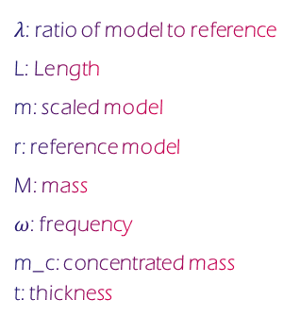
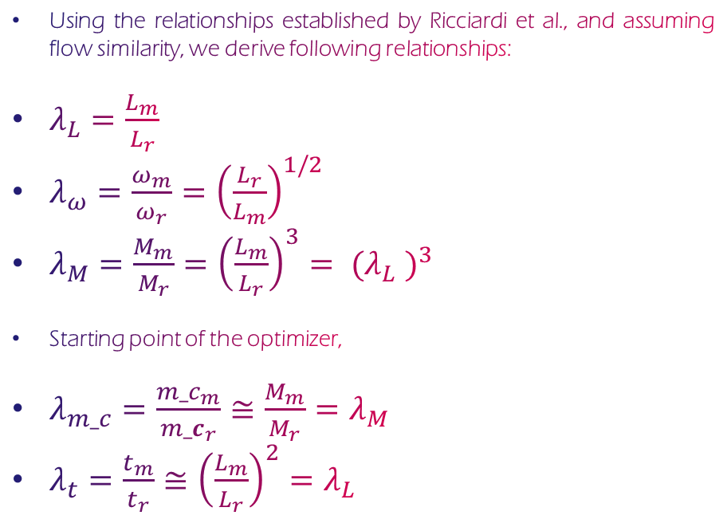
Adapted Scaling Methodology
Using the relationships established by Ricciardi et al., and assuming flow similarity, we derive following relationships:
$λ_{L}=\frac{L_{m}}{L_{r}}$
$λ_{ω}=\frac{ω_{m}}{ω_{r}}={\left(\frac{L_{r}}{L_{m}}\right)}^{1/2}$
$λ_{M}=\frac{M_{m}}{M_{r}}={\left(\frac{L_{m}}{L_{r}}\right)}^{3}= {{(λ}_{L} )}^{3}$
Starting point of the optimizer,
$λ_{m_c}=\frac{{m_c}_{m}}{{m_c}_{r}}≅\frac{M_{m}}{M_{r}}=λ_{M}$
$λ_{t}=\frac{t_{m}}{t_{r}}≅{\left(\frac{L_{m}}{L_{r}}\right)}^{2}=λ_{L}$
$λ$: ratio of model to reference
L: Length
m: scaled model
r: reference model
M: mass
$ω$: frequency
m_c: concentrated mass
t: thickness

Slide 13





Tools Framework
OpenNASTRAN
Solver
Chaining Tool
Optimization Tools
Visualization Tools
COBYLA

Slide 14
Optimization Schedule
Initial Thicknesses & Masses
NASTRAN MODAL ANALYSIS
Ref. Mode shapes, Frequencies, Mass
Mode shapes, Frequencies, Mass
MODAL FUNCTIONS
(MAC Computation)
No
Convergence?
Yes
Post-processing
Optimized thickness and masses, mode shapes, MAC

Slide 15
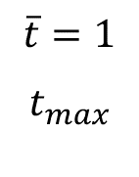
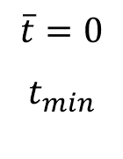
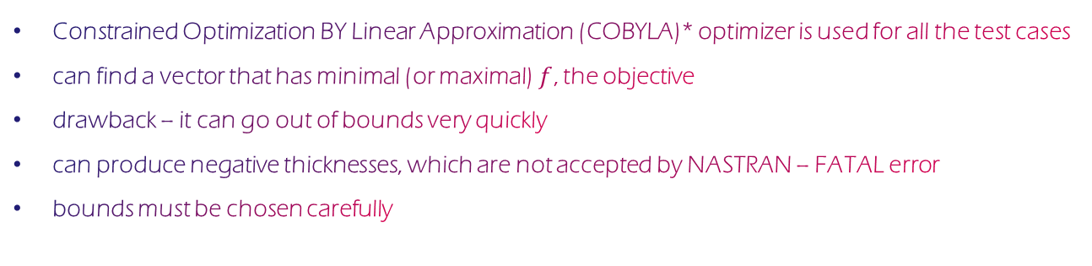
About the Optimizer
Constrained Optimization BY Linear Approximation (COBYLA)* optimizer is used for all the test cases
can find a vector that has minimal (or maximal)$f$, the objective
drawback – it can go out of bounds very quickly
can produce negative thicknesses, which are not accepted by NASTRAN – FATAL error
bounds must be chosen carefully
negative reach
‘rhobeg’
$$\overline{t}=0$$
$$t_{min}$$
$$\overline{t}=1$$
$$t_{max}$$
* Scipy.org

Slide 16
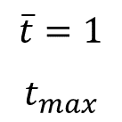
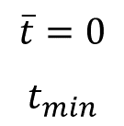
About the Optimizer (avoiding negative values of design variables)
negative reach
‘rhobeg’
$$\overline{t}=0$$
$$t_{min}$$
$$\overline{t}=1$$
$$t_{max}$$
#Design variable boundaries
Group normalization of bounds:
t_max = 60.*np.ones(6)
t_min = 1.*np.ones(6)
m_max = 0.6*np.ones(3)
m_min = 0.01*np.ones(3)
Individual normalization of bouns:
t_max = 30.*t_0
t_min = 0.3*t_0
m_max = 0.3*m_0
m_min = 0.003*m_0

Slide 17
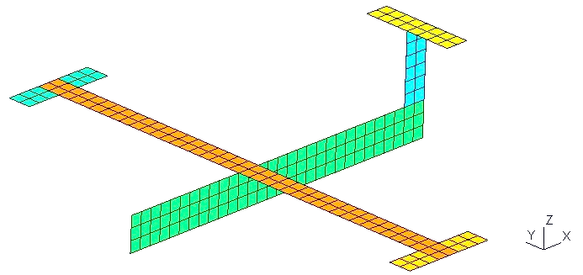
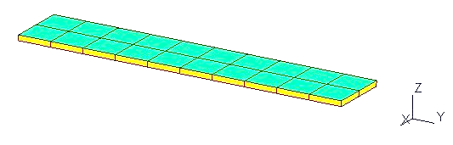
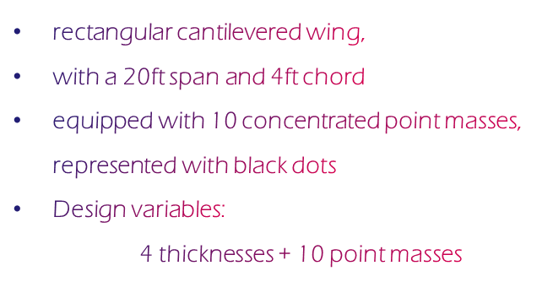
Test Cases
GOLAND wing
GARTEUR SM-AG19
rectangular cantilevered wing,
with a 20ft span and 4ft chord
equipped with 10 concentrated point masses, represented with black dots
Design variables:
4 thicknesses + 10 point masses
equipped with three concentrated point masses represented by black dots
full wing span of 2000 mm
The model is not constrained
rigid body mode should not be taken into consideration
Design variables:
6 thicknesses + 3 point masses

Slide 18
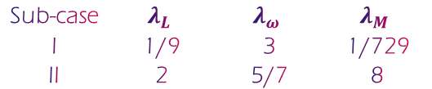
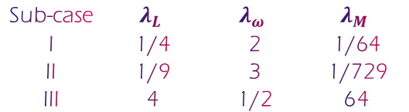
Test Sub-cases
GOLAND wing
GARTEUR SM-AG19
Sub-case | $$λ_{L}$$ | $$λ_{ω}$$ | $$λ_{M}$$
I | 1/4 | 2 | 1/64
II | 1/9 | 3 | 1/729
III | 4 | 1/2 | 64
Sub-case | $$λ_{L}$$ | $$λ_{ω}$$ | $$λ_{M}$$
I | 1/9 | 3 | 1/729
II | 2 | 5/7 | 8

Slide 19
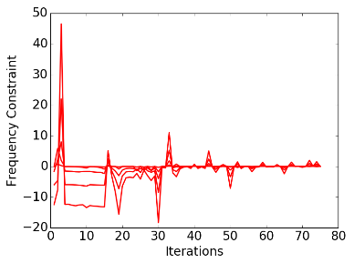
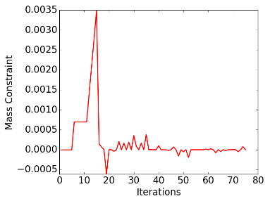
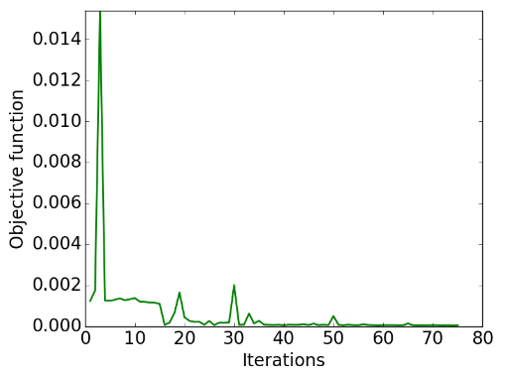
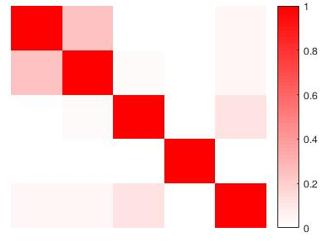
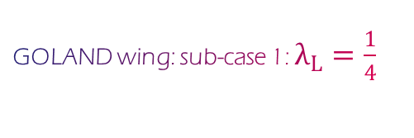
Results
GOLAND wing: sub-case 1: $λ_{L}=\frac{1}{4}$
Convergence Graphs
MAC Matrix
Mode | Reference Value | Target Value | Optimized Value | Error%
1 | 2.40 | 4.794 | 4.795 | 8e-3
2 | 8.65 | 17.301 | 17.300 | 3e-3
3 | 13.22 | 26.445 | 26.446 | 5e-3
4 | 15.94 | 31.887 | 31.890 | 1e-2
5 | 24.11 | 48.228 | 48.228 | 1e-4
Mass (slugs) | 32.871 | 0.51 | 0.51 | 5e-5

Slide 20
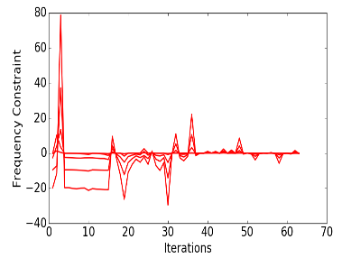
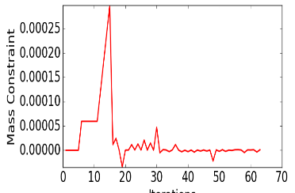
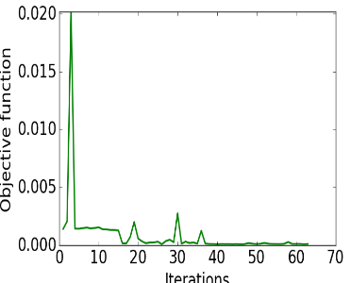
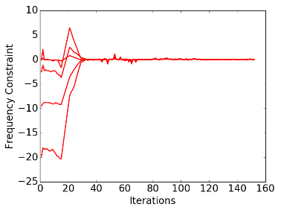
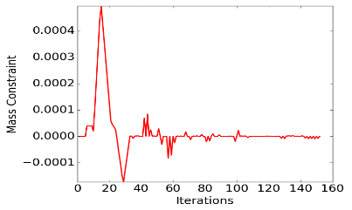
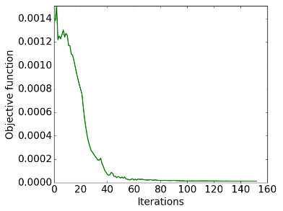
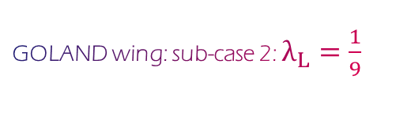
Results
GOLAND wing: sub-case 2: $λ_{L}=\frac{1}{9}$
Convergence Graphs: Group normalization of DV bounds
Convergence Graphs: Individual normalization of DV bounds

Slide 21
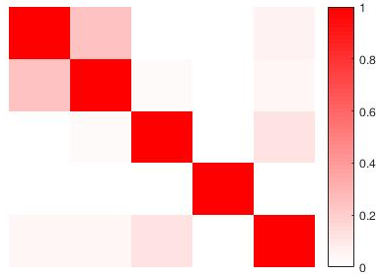
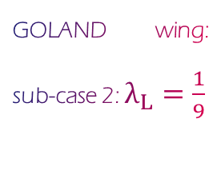
Results
GOLAND wing: sub-case 2: $λ_{L}=\frac{1}{9}$
Mode | Reference Value | Target Value | Optimized Value | Error%
1 | 2.40 | 7.191 | 7.192 | 1e-2
2 | 8.65 | 25.951 | 25.933 | 7e-2
3 | 13.22 | 39.667 | 39.665 | 4e-3
4 | 15.94 | 47.831 | 47.842 | 2e-2
5 | 24.11 | 72.342 | 72.307 | 4e-2
Mass (slugs) | 32.871 | 0.05 | 0.05 | 7e-6
MAC Matrix

Slide 22
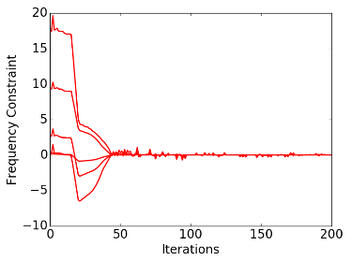
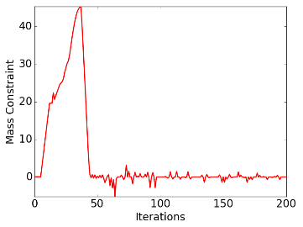
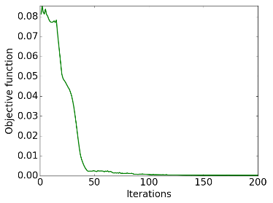
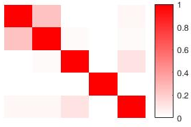
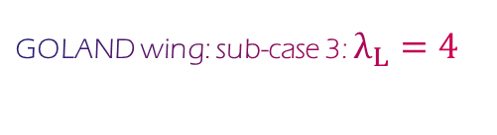
Results
GOLAND wing: sub-case 3: $λ_{L}=4$
Convergence Graphs
MAC Matrix
Mode | Reference Value | Target Value | Optimized Value | Error%
1 | 2.40 | 1.199 | 1.199 | 4e-5
2 | 8.65 | 4.325 | 4.325 | 2e-3
3 | 13.22 | 6.611 | 6.611 | 2e-4
4 | 15.94 | 7.972 | 7.972 | 1e-5
5 | 24.11 | 12.057 | 12.057 | 1e-3
Mass (slugs) | 32.871 | 2103.74 | 2103.81 | 3e-5

Slide 23
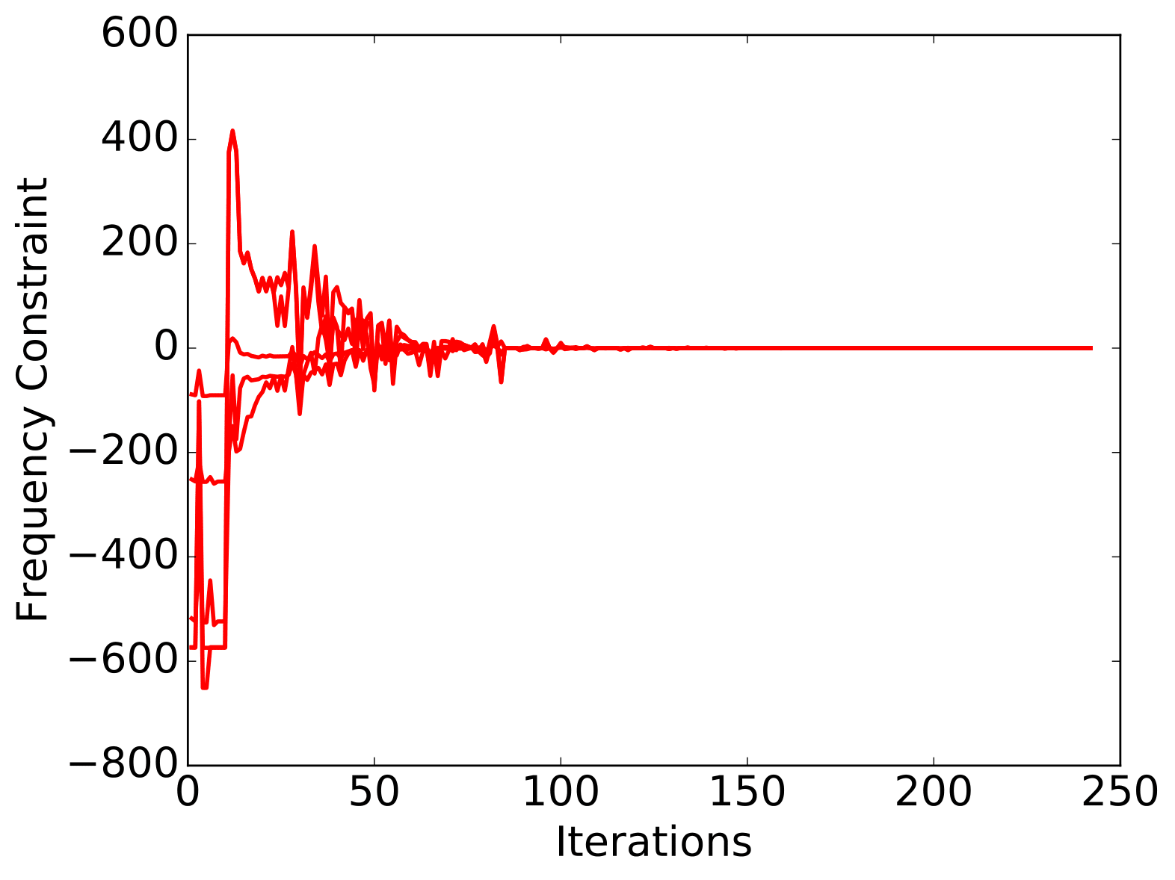
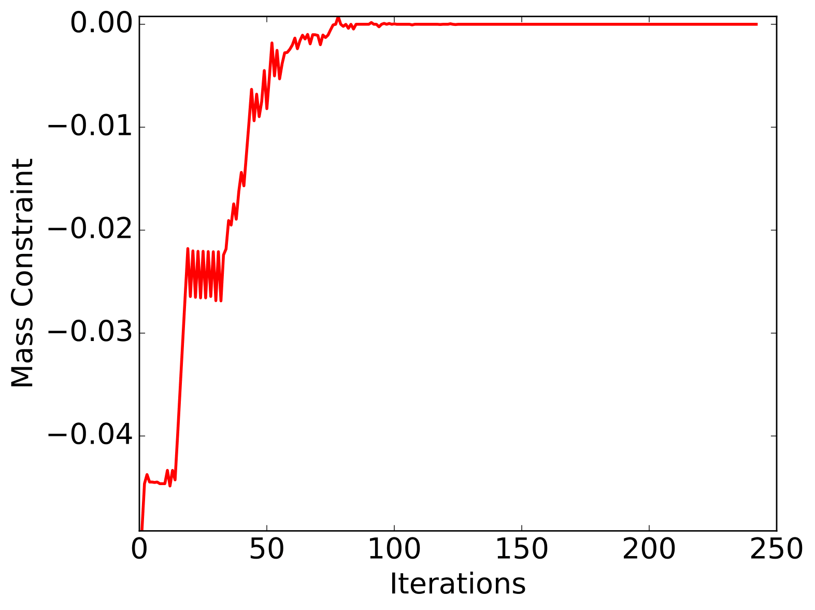
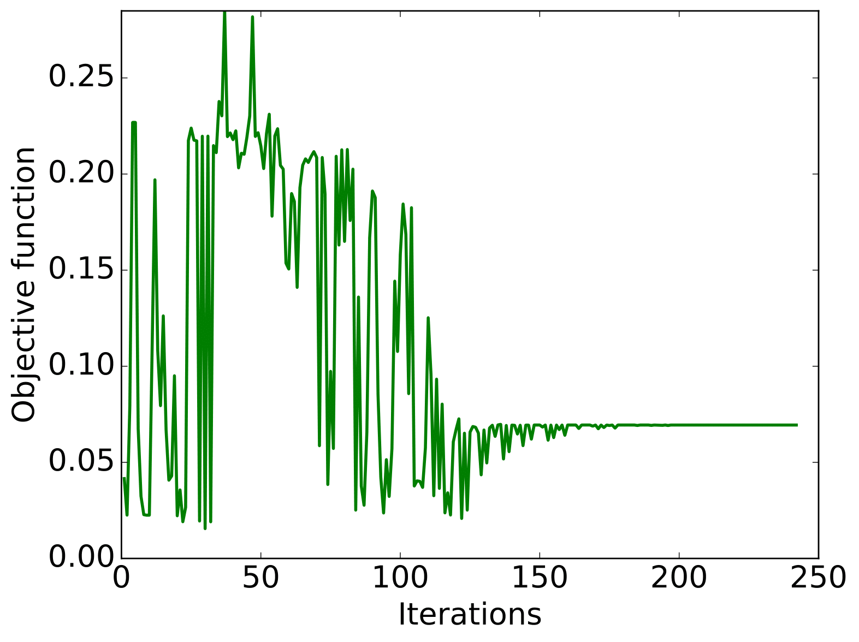
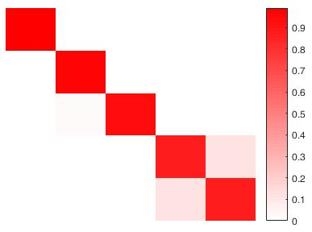
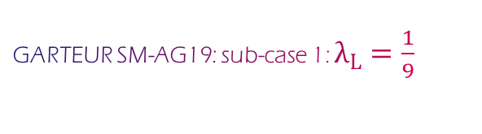
Results
GARTEUR SM-AG19: sub-case 1: $λ_{L}=\frac{1}{9}$
Convergence Graphs
MAC Matrix
Mode | Reference Value | Target Value | Optimized Value | Error%
1 | 6.37 | 19.100 | 19.100 | 0e+0
2 | 17.32 | 51.955 | 51.955 | 0e+0
3 | 39.37 | 118.098 | 118.098 | 2e-5
4 | 46.02 | 138.045 | 138.045 | 7e-6
5 | 46.08 | 138.243 | 138.243 | 2e-5
Mass (kg) | 41.2650 | 0.0566 | 0.0566 | 2e-8

Slide 24
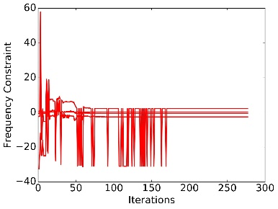
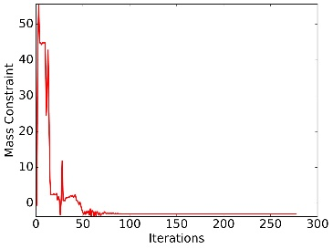



Results
GARTEUR SM-AG19: sub-case 2: $λ_{L}=2$
Convergence Graphs
Mode | Reference Value | Target Value | Optimized Value | Error%
1 | 6.37 | 4.548 | 4.584 | 8e-1
2 | 17.32 | 12.370 | 12.279 | 7e-1
3 | 39.37 | 28.119 | 23.175 | 1.7e+1
4 | 46.02 | 32.868 | 28.473 | 1.3e+1
5 | 46.08 | 32.915 | 30.625 | 6.9e+1
Mass (kg) | 41.2650 | 330.12 | 327.15 | 8.9e-1
MAC Matrix

Slide 25

Results
GARTEUR SM-AG19: sub-case 2: $λ_{L}=2$
Convergence Graph: Objective function
MAC Matrix
$$≈0.6$$
Method to resolve:
Increasing the total number of modes extracted , M
Increasing the design space

Slide 26
Future Works
Try to use ‘mayavi’ package on Python to plot the normal modes
Dynamic modal optimization of scaled models of BWB
Flutter analysis for reference BWB
Flutter optimization for scaled models of BWB:
With flow non-similarity, we have to compare the flutter response of each scaled model and make corrections in the aerodynamic models according to the parameters of each scale (Mach, Reynolds,...)

Slide 27
References
[1] Anthony P. Ricciardi, Geometrically Nonlinear Aeroelastic Scaling, PhD Dissertation at Faculty of the Virginia Polytechnic Institute and State University
[2] Richards et al. Multidisciplinary Design for Flight Test of a Scaled Joined Wing SensorCraft, AIAA 2010-9351
[3] Ricciardi et al., Nonlinear Aeroelastic-Scaled-Model Optimization Using Equivalent Static Loads, AIAA 2014
[4] Ricciardi et al., Nonlinear Aeroelastic Scaled Model Design, Journal of Aircraft, 2016
[5] Tiago José Fernandes Pires, Linear Aeroelastic Scaling of a Joined Wing Aircraft, Masters Thesis, Técnico Lisboa, July 2014.
[6] Richards et al. Design of a Scaled RPV for Investigation of Gust Response of Joined-Wing Sensorcraft, AIAA 2009-2218
[7] Mas Colomer et al. Similarity Maximization of a Scaled Aeroelastic Flight Demonstrator via Multidisciplinary Optimization. AIAA 2017-0573
[8] https://github.com/nasa/NASTRAN-95
[9] https://docs.scipy.org/doc/scipy-0.14.0/reference/generated/scipy.optimize.fmin_cobyla.html
Thanks for your attention!

